Slide 1
Exploratory Data Analysis

Slide 2
Team 4
Ashish Dass - dass.s@husky.neu.edu
Anamika Jha - jha.a@husky.neu.edu
Shruti Narain - narain.s@husky.neu.edu
In DATA we TRUST!!

Slide 3
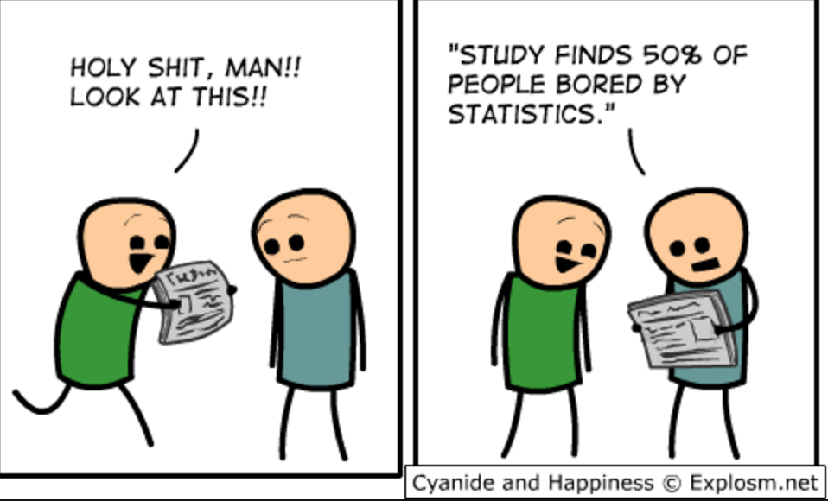
Every day, three times per second, we produce the equivalent of the amount of data that the Library of Congress has in its entire print collection, right? But most of it is like cat videos on YouTube or 13-year-olds exchanging text messages about the next Twilight movie.
– Nate Silver

Slide 4
Analysis of Bank Filings Data
1
– Data Wrangling and Exploratory data analysis
using Tableau
Case Study

Slide 5
Step1:
Scrapping data from the below url for 15 quarters into 15 different csv files using R https://www.ffiec.gov/nicpubweb/nicweb/HCSGreaterThan10B.aspx
install.packages("rvest")
install.packages("RSelenium")
remDrv <- remoteDriver(remoteServerAddr = "localhost", port = 4444, browserName = "firefox")
remDrv$navigate("https://www.ffiec.gov/nicpubweb/nicweb/HCSGreaterThan10B.aspx")
timeframe <- xpathSApply(html page, "//option", function(u) xmlAttrs(u)["value"])
for(i in timeframe){
option <- remDrv$findElement(using = 'xpath', paste('//*/option[@value=',i,"]"))
option$clickElement()
xt <- readHTMLTable(tables[[3]]…………………)
write.csv(xt, file = paste("quarter_",i,'.csv'))
}

Slide 6
Step2:
Cleaning and merging data from all 15 csv files into a single csv file in the form of stacked data and unstacked data
Merging all 15 csv files (STACKED) and renaming column header for the purpose of merging
for (i in timeframe){
y <- data.frame(read.csv(paste("quarter_",i,".csv"), header = TRUE))
x<-replicate(nrow(y),i)
y$quarter <- as.Date(x,"%Y%m%d")
colnames(y) <- c('SNo', 'Rank','Company', 'Location', 'Assets', 'Quarter')
w <- rbind(w,y) }
Splitting company ID and Location
install.packages('reshape2')
w1 <- with(w, cbind(Rank, colsplit(w$Company, pattern = "\\(", names = c('Institution Name', 'RSSDId')),colsplit(w$Location, pattern = "\\,", names = c('City', 'State')), Assets, Quarter))
w2 <- as.data.frame(sapply(w1,gsub,pattern=")",replacement=""))

Slide 7
Merging all 15 csv files (UNSTACKED )and renaming column header for the purpose of merging
unstacked = NULL
counter <- 1
for (i in timeframe){
unstacked_ <- data.frame(read.csv(paste("quarter_",i,".csv"), header = TRUE))
quarter_row<-replicate(nrow(unstacked_),i)
unstacked_$quarter <- as.Date(quarter_row,"%Y%m%d")
colnames(unstacked_) <- c('SNo', 'Rank','Company', 'Location', 'Assets', 'Quarter')
if (counter == 1){
unstacked <- unstacked_
counter <- 2
} else{
unstacked <- merge(unstacked,unstacked_, by="Company“ , all.unstacked =TRUE , all.unstacked_= TRUE)
}
}

Slide 8
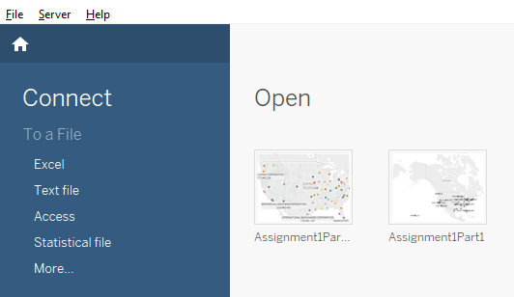
Step 3:
Importing the csv file (which has stacked data) as a “text” file in Tableau for the purpose of analysis

Slide 9
Dashboards

Slide 10
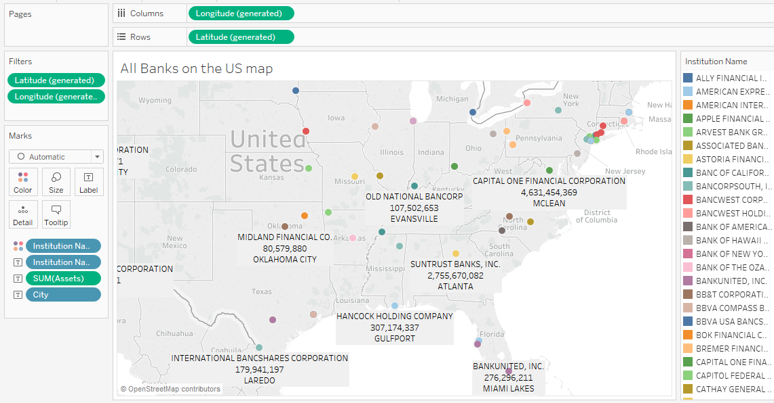
All banks on the US Map using location information
All the banks with their total assets and city , highlighted with different colors on the map

Slide 11
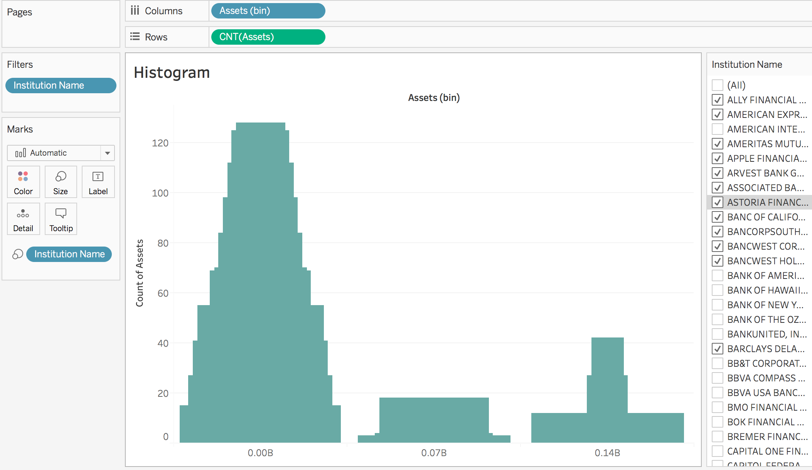
1.a: Histogram describing the banks by value

Slide 12
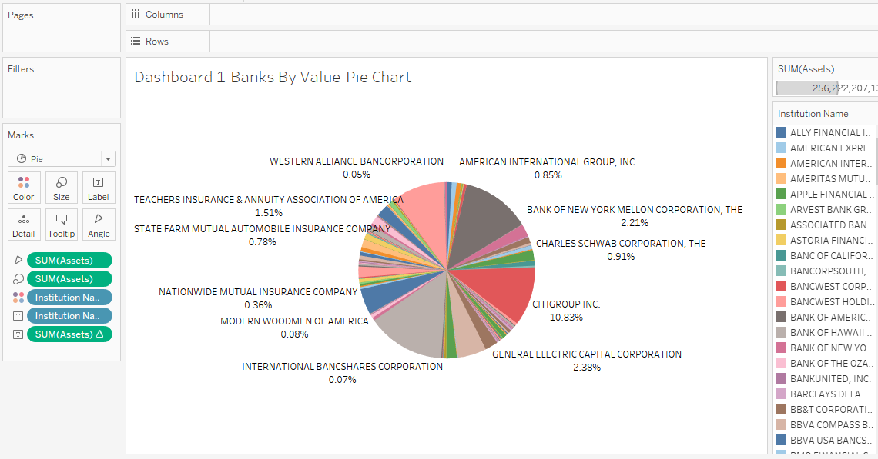
1.b: Pie Chart describing the banks by value
Based on 15 quarters, the pie chart represents that, the major portion is occupied by companies like JP Morgan(14%), Bank of America(12%), Citi group(10%), etc.

Slide 13
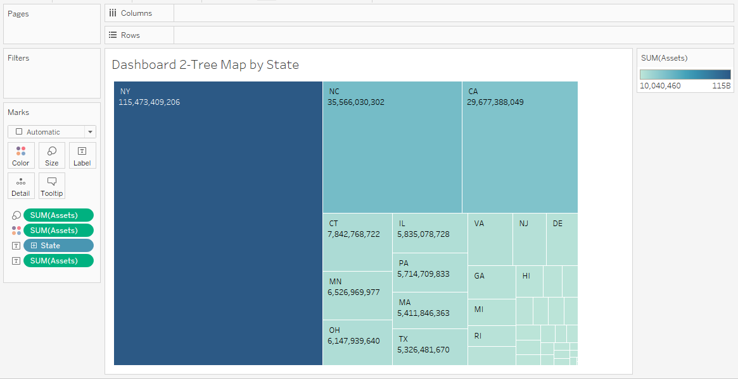
2: Tree Map by State
The chart represents that the states with almost similar assets have similar size and color.
The size of the rectangle decreases with decrease in the total asset value .

Slide 14
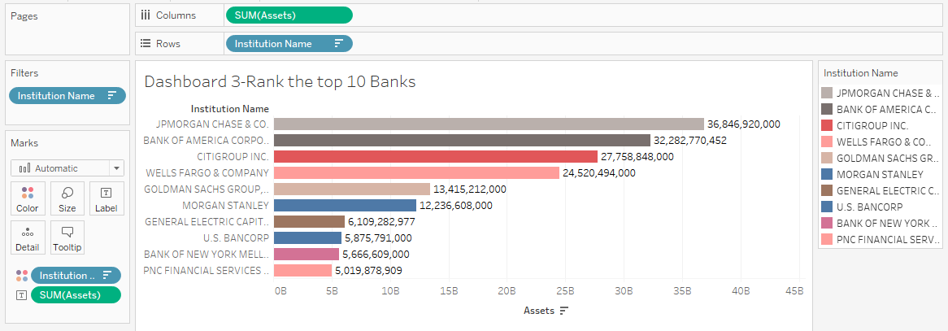
3.1: Ranking the top 10 banks
The ranking of top 10 banks is based on total assets combined using 15 quarters.

Slide 15
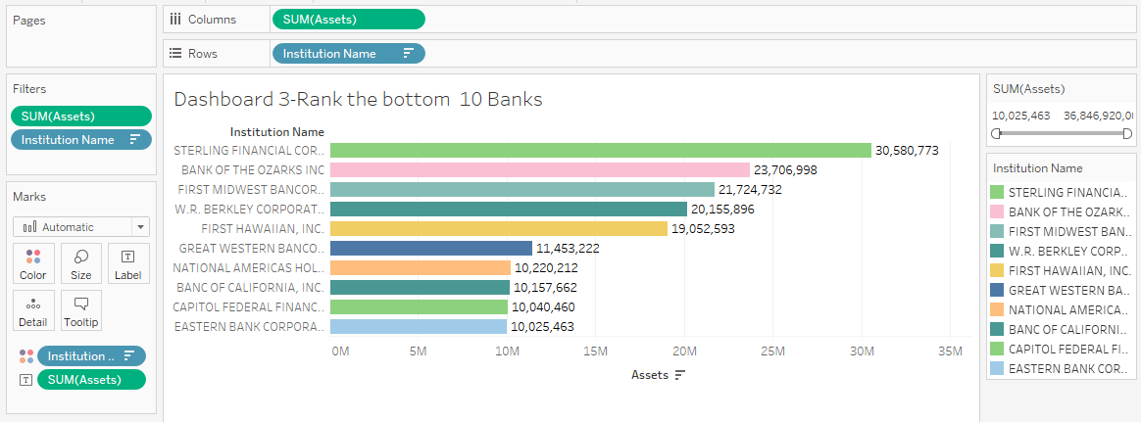
3.2: Ranking the bottom 10 banks
The ranking of bottom 10 banks is based on total assets combined using 15 quarters.

Slide 16
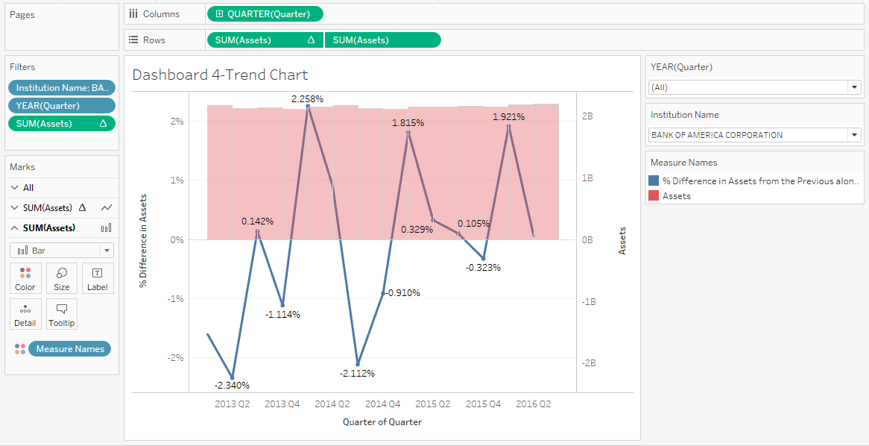
4: Trend Charts - per company
The chart consists of trend lines that represent growth rate.
With decrease in asset value for a particular quarter, the line goes in the negative quadrant.

Slide 17
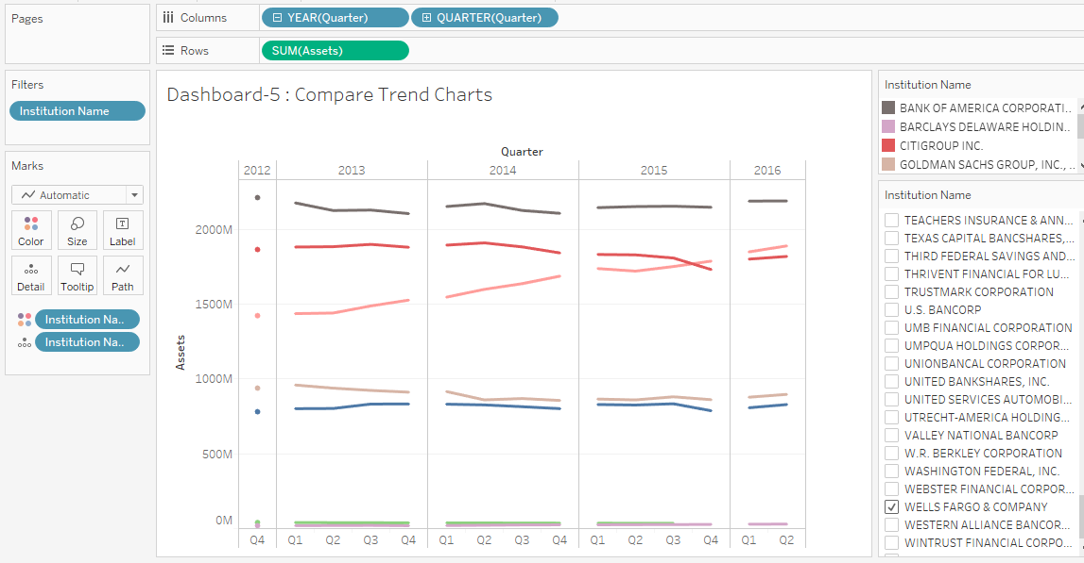
5: Comparing companies using Trend Charts
Different trend lines represent different companies for all 15 quarters.

Slide 18
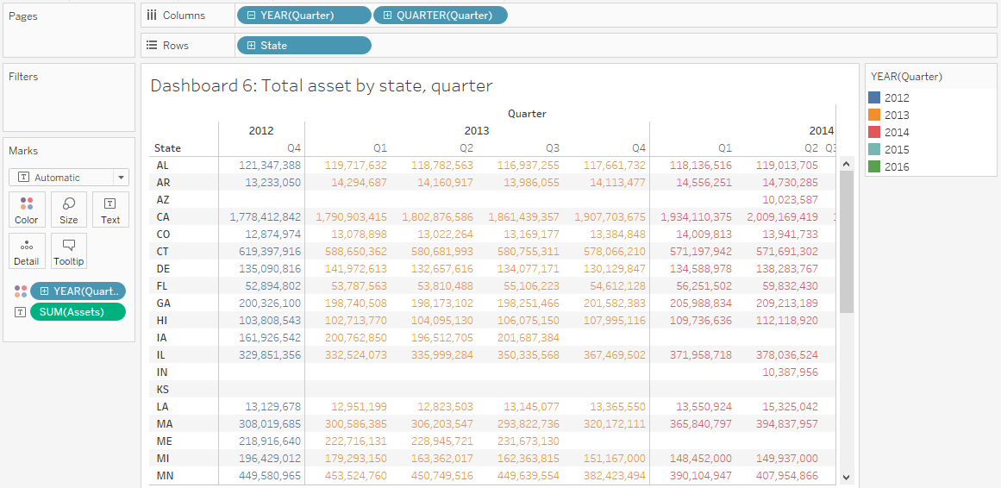
6: Pivot table- total asset by state, quarter
The table represents total assets for all the states, year wise and quarter wise

Slide 19
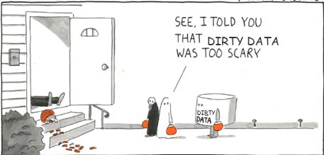
Data scraping
2
– Data Wrangling and Exploratory data analysis
using Tableau
Case Study

Slide 20
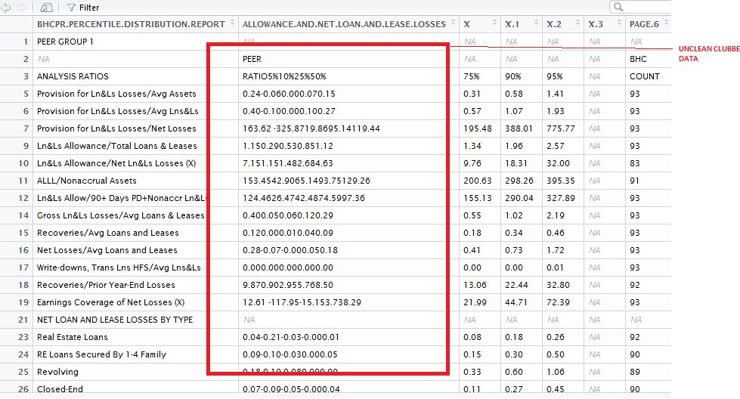
1: Very Unclean Data

Slide 21
Step1:
Package to read pdf's not in cran as a library yet, but a project extracted from github
https://github.com/ropenscilabs/tabulizer
install.packages("devtools", dependencies = TRUE)
library(devtools)
devtools::install_github(c("ropenscilabs/tabulizerjars", "ropenscilabs/tabulizer"), args = "--no- multiarch")
Step 2:
Set this to your jre link in the system
Sys.setenv(JAVA_HOME='C://Program Files//Java//jre1.8.0_101')
install.packages("rJava")
library(rJava)

Slide 22
Step3:
To read tables from pdf, data manipulation and string splitiing of column cells to clean dirty/combined data
install.packages("devtools", dependencies = TRUE)
library(devtools)
devtools::install_github(c("ropenscilabs/tabulizerjars", "ropenscilabs/tabulizer"), args = "--no- multiarch")

Slide 23
Step 5:
Step 4:
Extracting the file
f <-system.file("examples", "PeerGroup_1_March2016.pdf",package="tabulizer")
Making tabular structure of each page [list of 28 pages as 28 tables]
out1 <- extract_tables(f,guess=FALSE,method = "data.frame")
Step 6:
Initialize the final result data set
dfresult <- NULL

Slide 24
Step 7:
Now the pdf structure is such that the pdf's each table is broken in 2 halves
set 1:- page 1- page 13
set 2:- page 14- page 26
set 3:- page 27,28
j <- 14
i<-1
Step 8:
for(i in length(out1)/2-1)

Slide 25
Step 9:
Logic to replace empty values as na, if "all" cell values are na we "remove" the row
also remove the rows havin '---' as the values first for 2nd half of pdf's, second for 1st half
df2 <-as.data.frame(apply(out1[[j]], 2, function(x) gsub("^$|^ $", NA, x)))
row.has.na <-(apply(df2, 1, function(x){all(is.na(x))}))
sum(row.has.na)
df2 <-as.data.frame(df2[!row.has.na,])
del<-which(apply(df2, 1, function(x) any(grepl("\\--", x))))
df2<-df2[-del,]

Slide 26
Step 10:
Logic to unlist the values and flatten out the common cell values as a single list basically done to merge the 2 subsets of data to form 1 logical table logic to match the 'number of rows' to be able to do 'bind by column'
df2<-df2[-c(1:2),]
names(df2)=unlist(df2[c(1),])
names(df2)
df2 <- as.data.frame(df2[-1,])
df1<-df1[-c(1:2),]
names(df1)=unlist(df1[c(1),])
names(df2)
df1 <- as.data.frame(df1[-1,])

Slide 27
Step 12:
Step 11:
Clean the data by using regex patterns for subset 2 values that are stuck in 1 column used 'gsub' function to be able to remove columns with entire 'na' values
df2.trial <- data.frame(t(sapply(df2[,2], function(y) gsub('(^-*[0-9]*.[0-9]{2})(-*[0-9]*.[0-9]{2})(-*[0-9]*.[0-9]{2})(-*[0-9]*.[0-9]{2})(-*[0-9]*.[0-9]{2})(-*[0-9]*.[0-9]{2})(-*[0-9]*.[0-9]{2})(-*[0-9]*.[0-9]{2})', '\\1d\\2d\\3d\\4d\\5d\\6d\\7d\\8', y))))
divisions<-8
Clean the data by using regex patterns for subset 1 values that are stuck in 1 column
used 'gsub' function to be able to remove columns with entire 'na' values
df1.trial <- data.frame(t(sapply(df1[,2], function(y) gsub('(^-*[0-9]*.[0-9]{2})(-*[0-9]*.[0-9]{2})', '\\1d\\2', y))))
divisions<-2

Slide 28
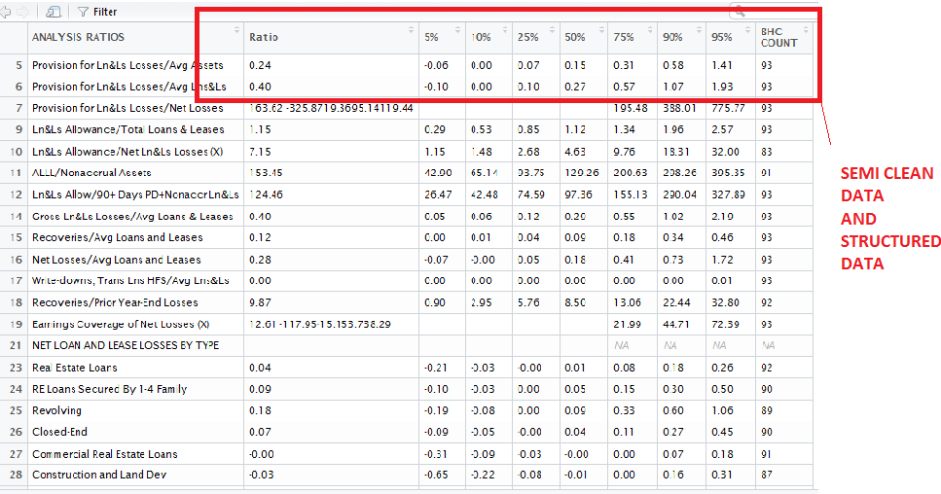
2: Semi Clean And Structured

Slide 29

Step 13:
cbind to form the original data tables that were distorted while being written on pdf's
if(nrow(df1.yo1)==nrow(df2.yo2))
dffinal1 <-(cbind(as.data.frame(df1.yo1),as.data.frame(df2.yo2)))
write.csv(dffinal1, file = paste("page_",i,'.csv'))
dffinal1.new<- dffinal1[,-7]
to_be_removed <- names(dffinal1.new)[1]
colnames(dffinal1.new)[1] <- "Parameters"
final row binding of all the data frames to make 1 csv
dfresult <- bind_rows(dfresult,dffinal1.new)
outputting the csv
write.csv(dfresult, file = paste("PEER1_2016","_Q1",'.csv'))
i<-i+1
j<-j+1

Slide 30
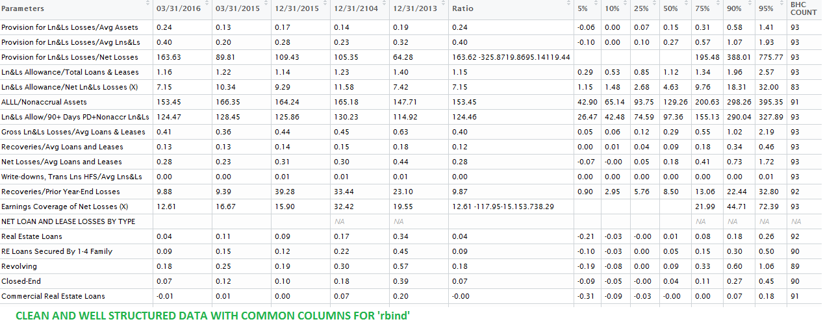
3: Clean, structured and beautiful data

Slide 31
Analysis of Banking Organization
3
Risk Reports for the years 2012, 2013 and 2014

Slide 32
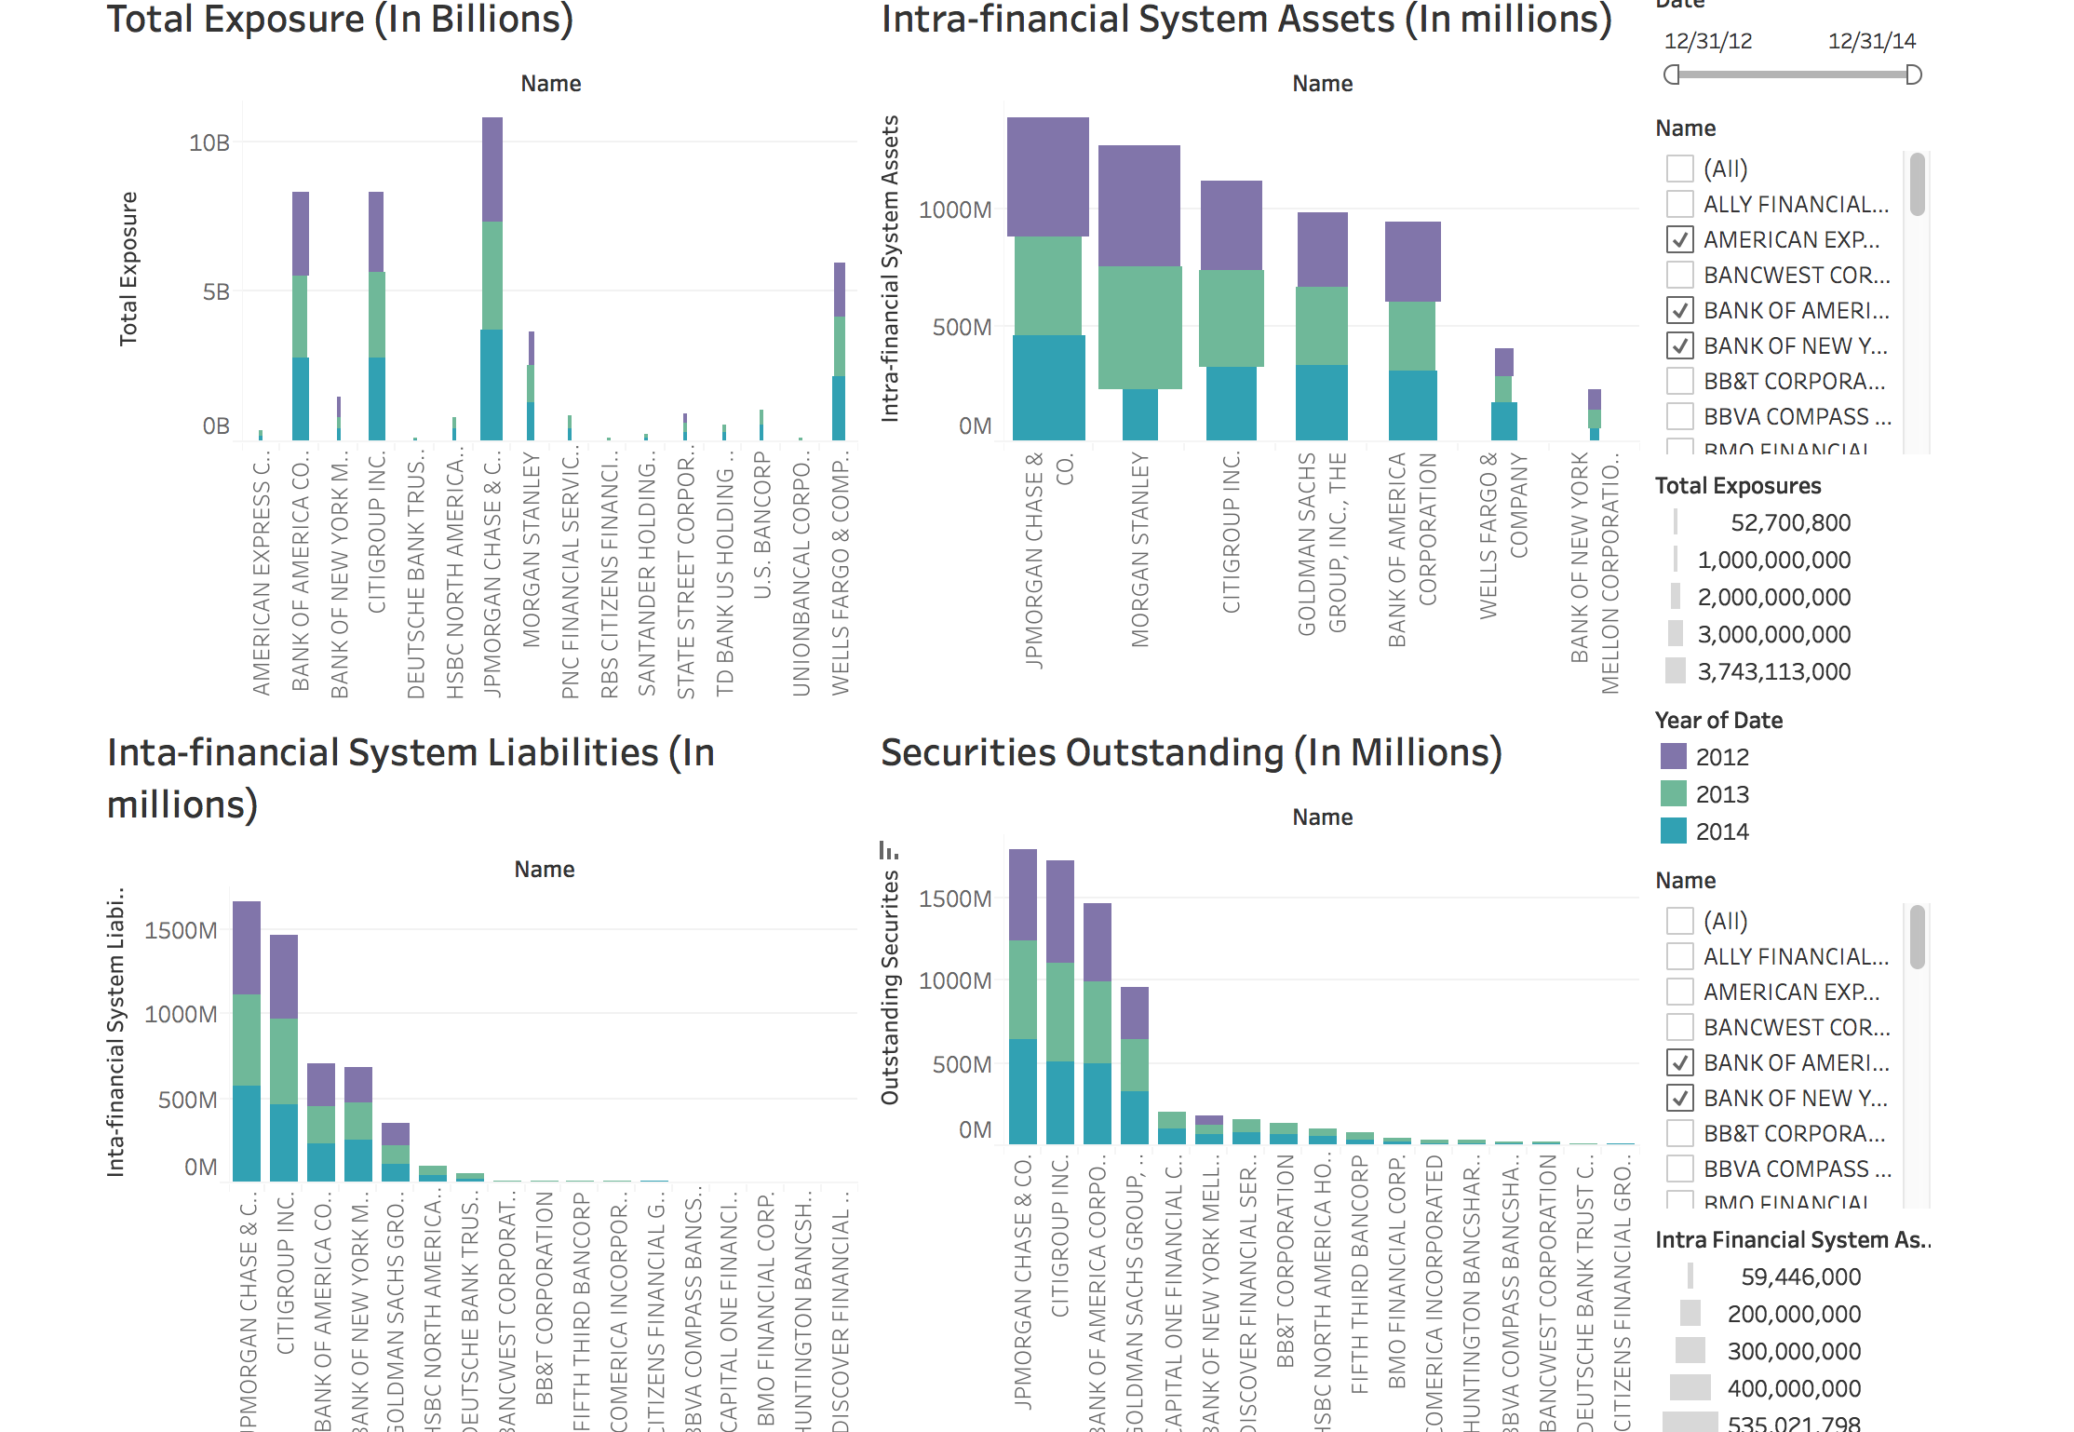
Graphs Dashboard
The charts are designed in the “Marimekko” design which represents the change in total exposure and Intra-financial system assets
The height along with the width represents the change in values over time.

Slide 33
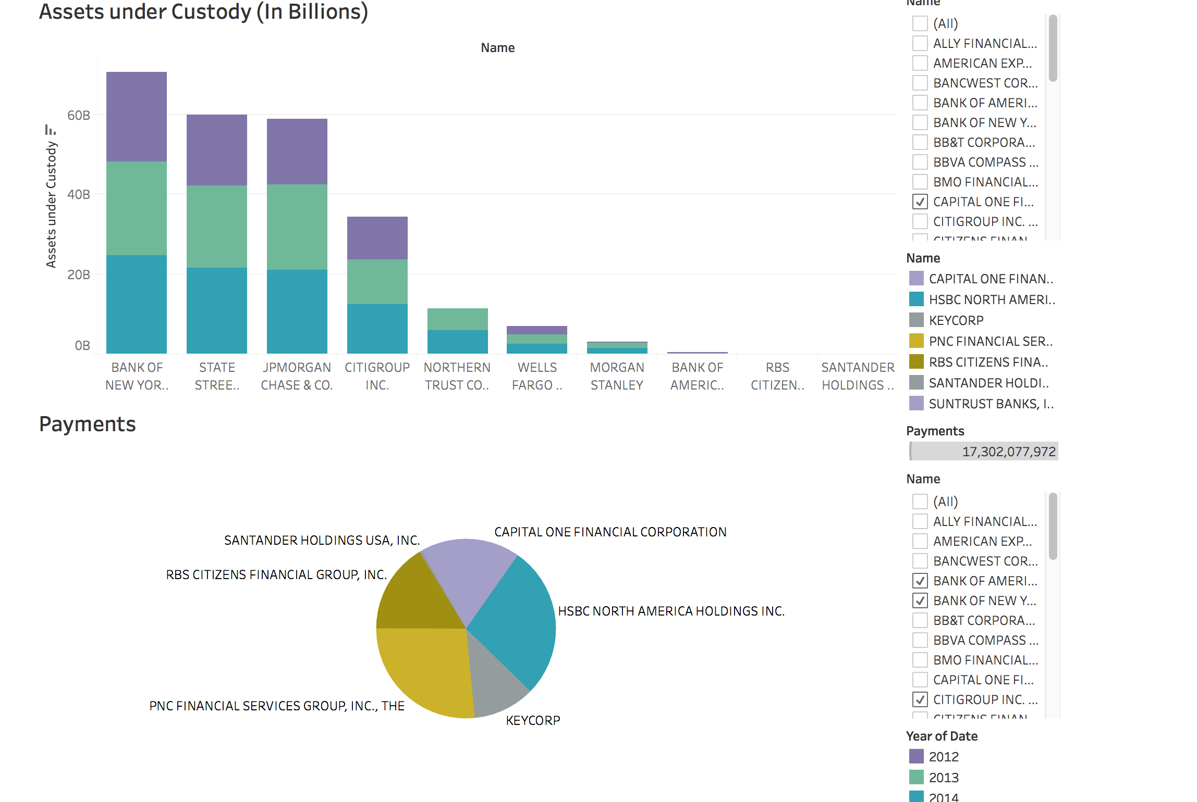
The bar chart represents the value of the clients assets held by the company over the period of 3 years.
The pie chart depicts the total payment value of different companies combined for all 3 years.

Slide 34
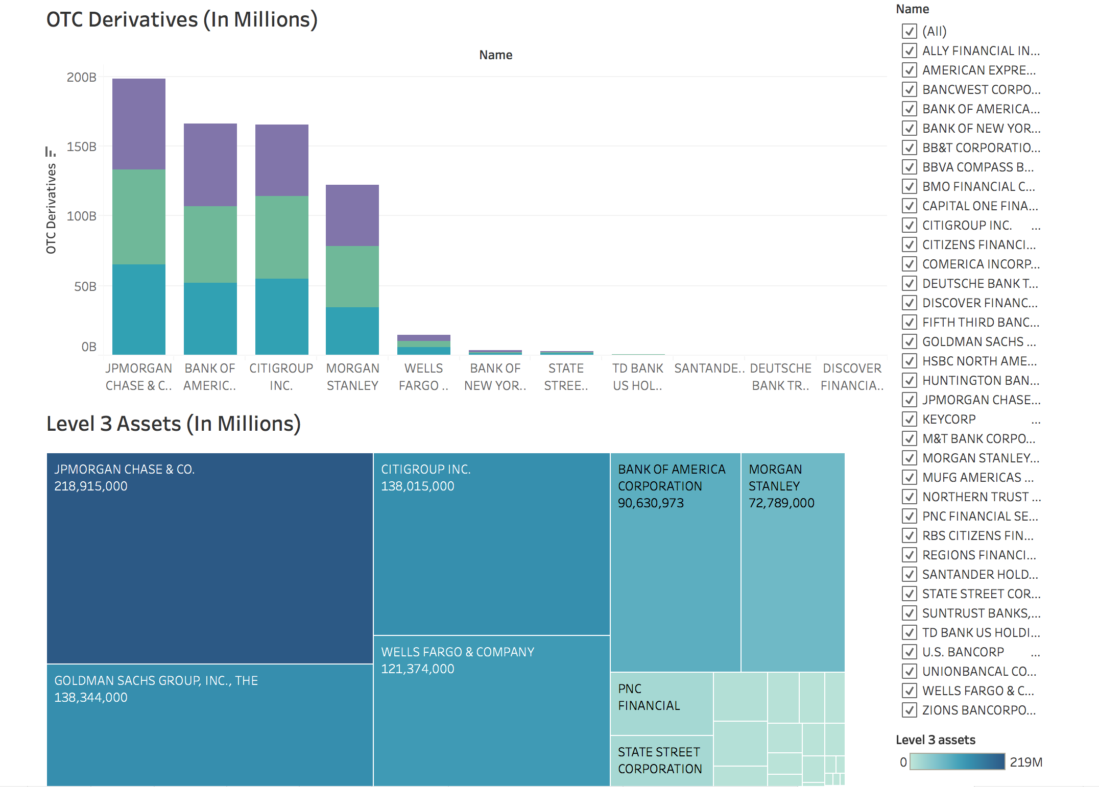
“Over-the-counter" (OTC) Derivatives refers to the derivatives that are traded through a dealer network as opposed to a centralized exchange such as New York Stock Exchange (NYSE). Different colors represent values for 3 different year.
From the tree map we see that JP Morgan holds the maximum level three assets for all the 3 years.

Slide 35
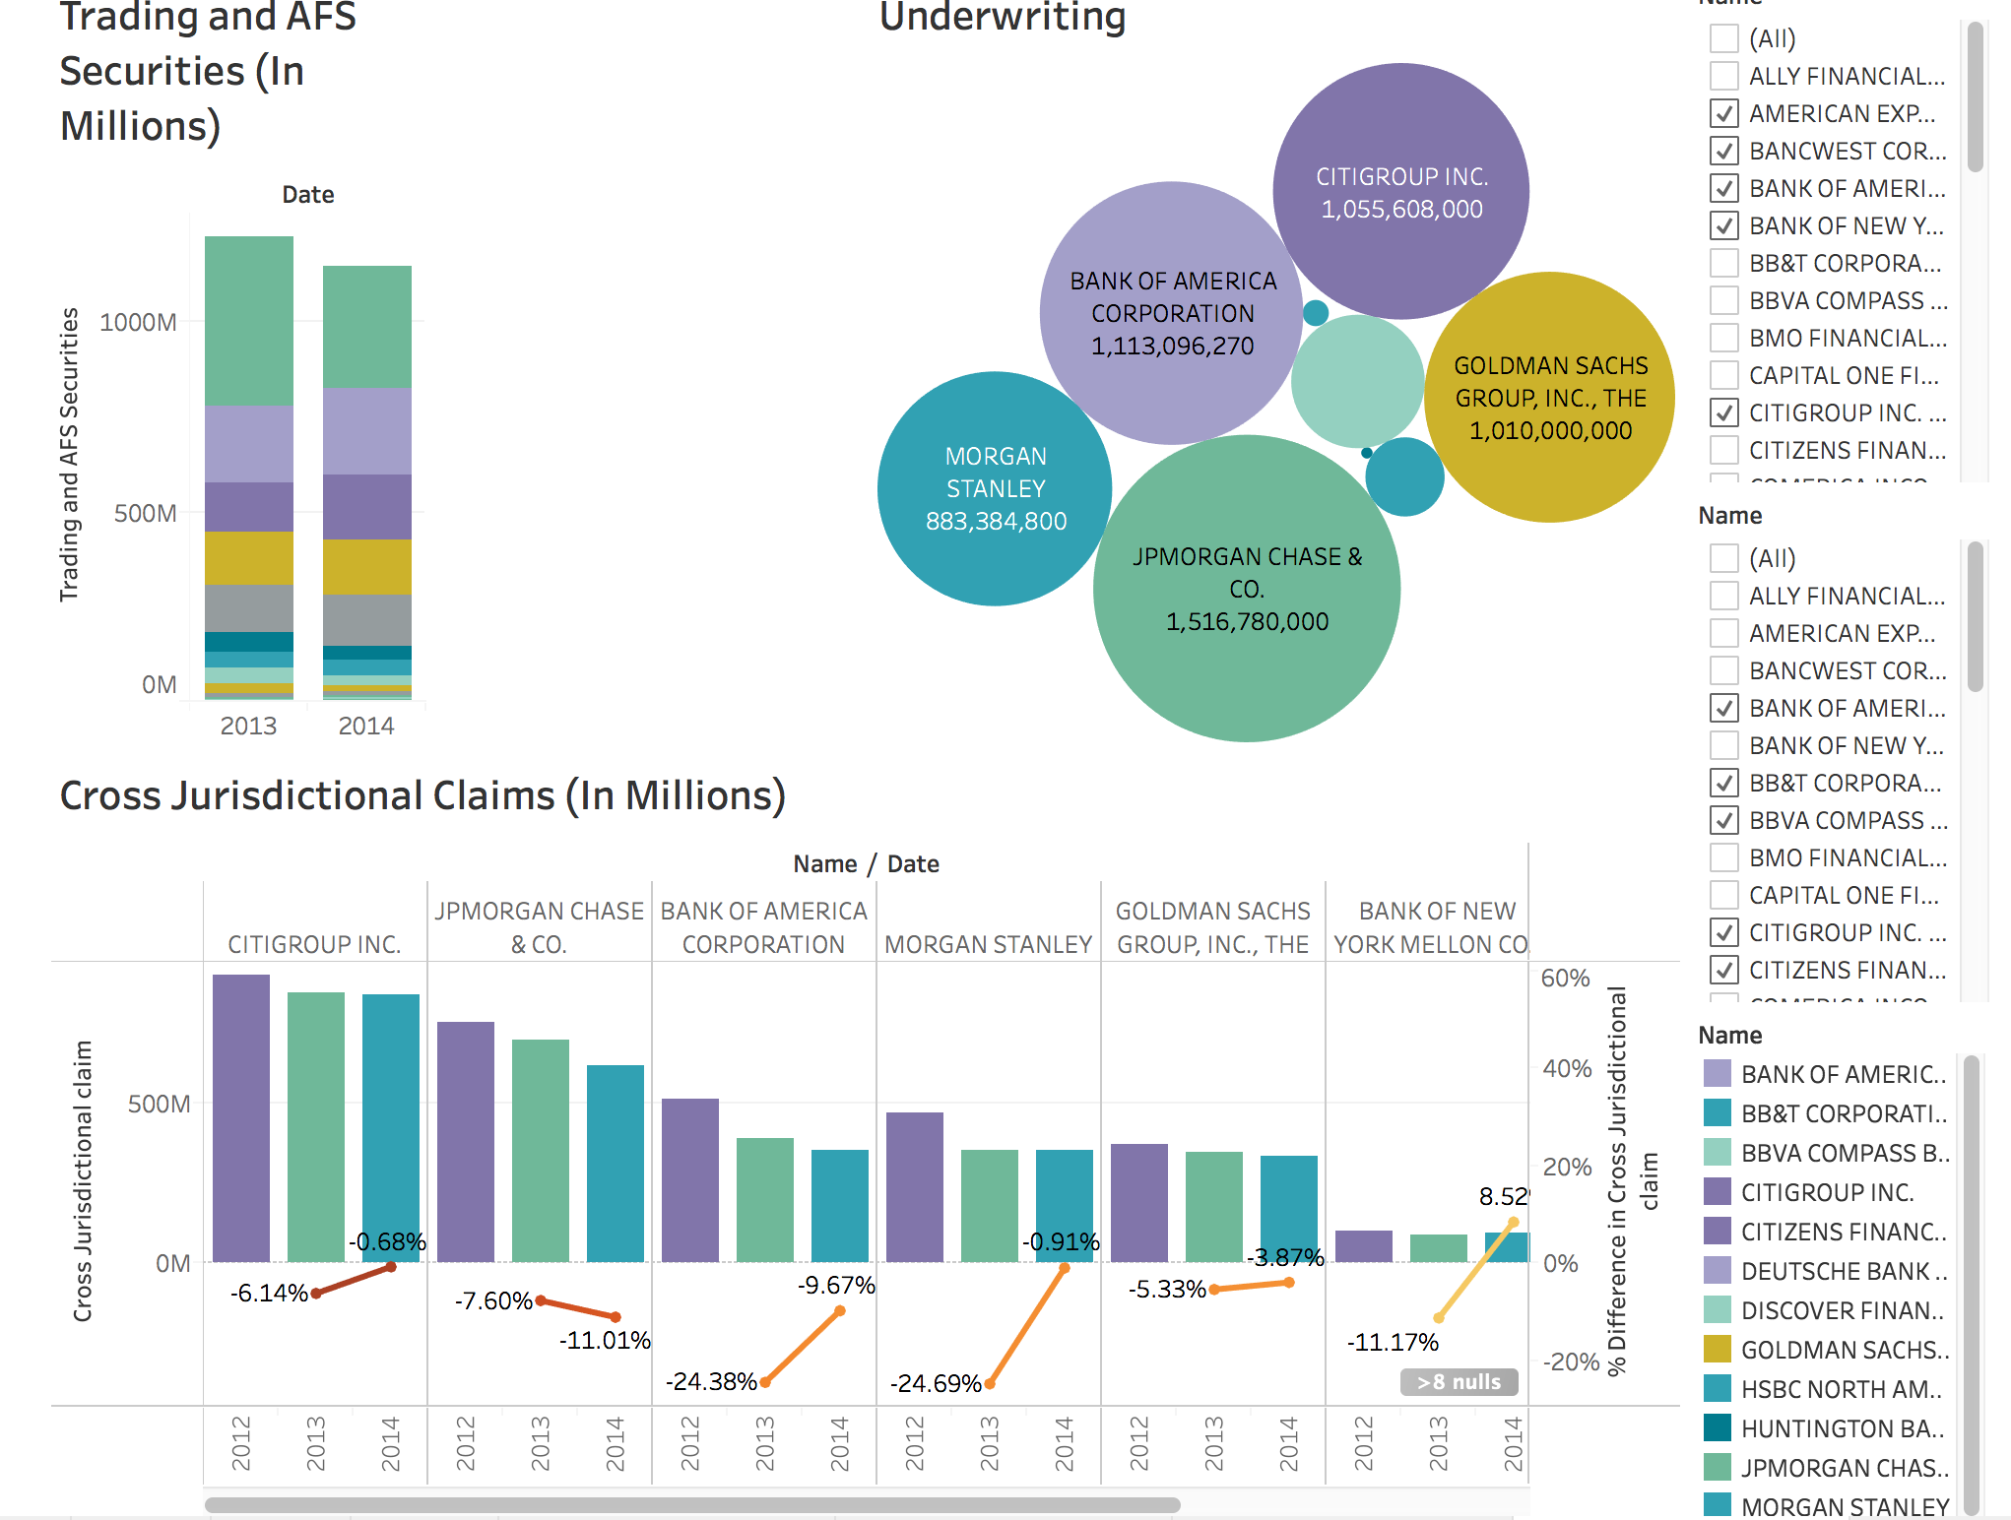
The bubble chart is showing the investment capital that each firm raised on behalf of their corporation. As JPMorgan has the highest value it is occupying the biggest bubble.
A cross claim jurisdiction represents a demand that is filed against a party on the same side of lawsuit. The trend chart clearly represents that over time the claims have declined for almost all the companies

Slide 36
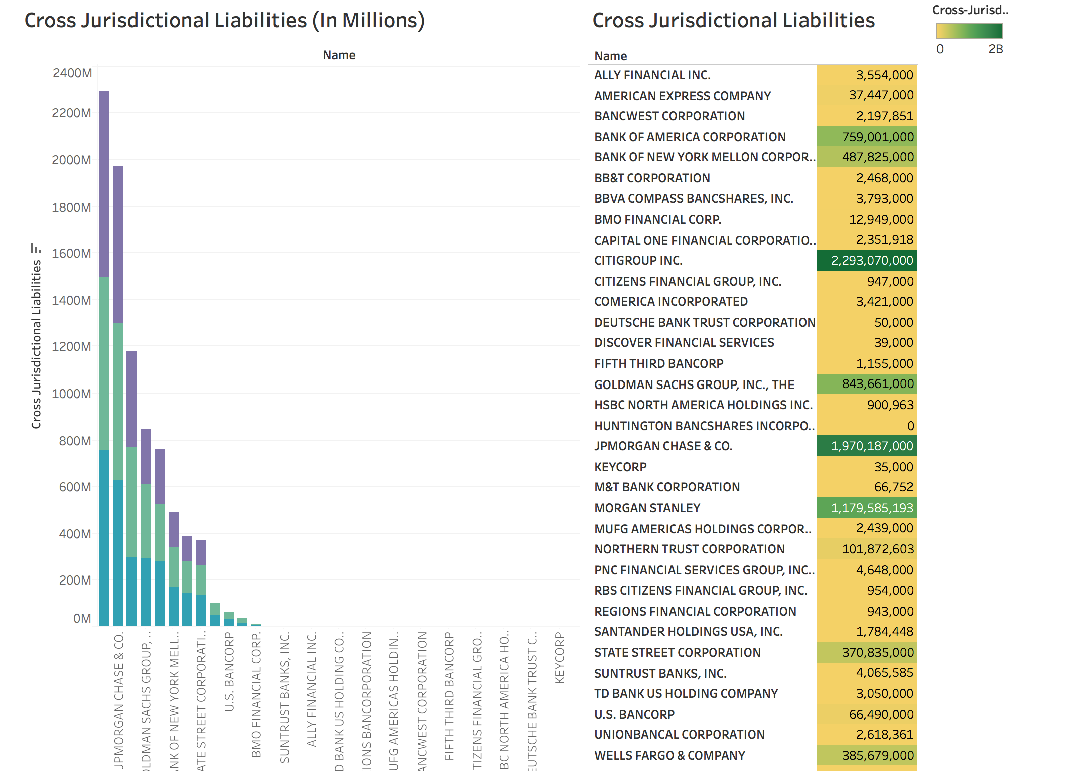
The table highlights the cross jurisdictional liabilities in different range. The green shows the maximum value and the yellow is minimum.

Slide 37
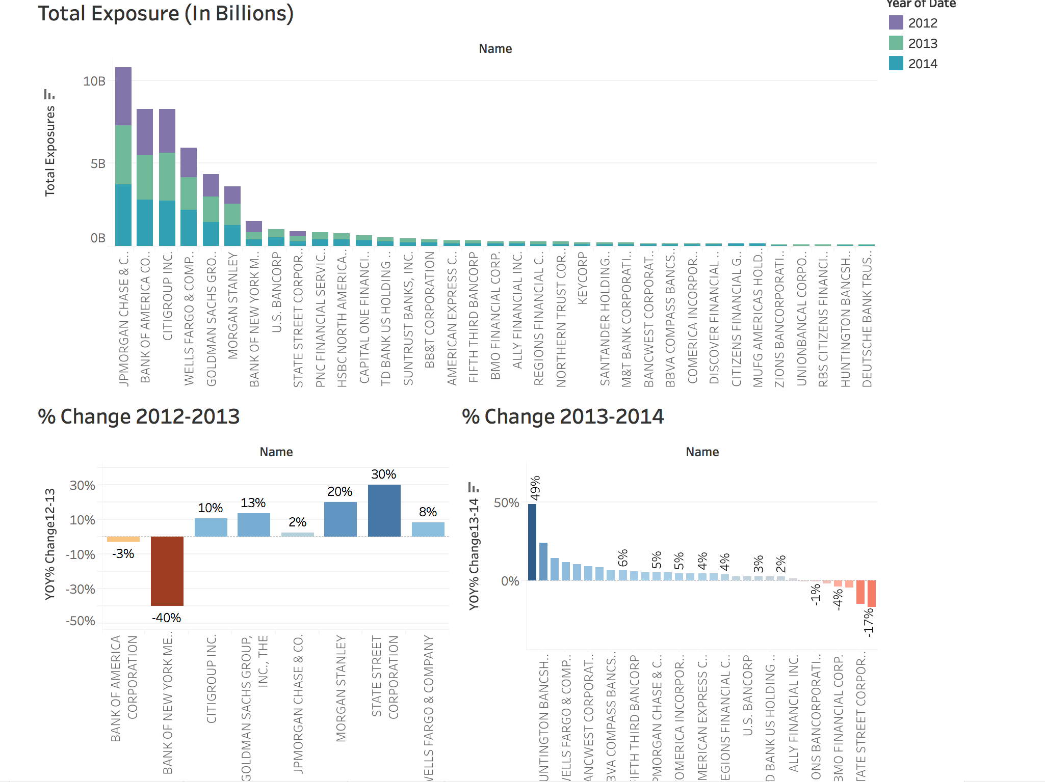
Time Series Dashboard:

Slide 38
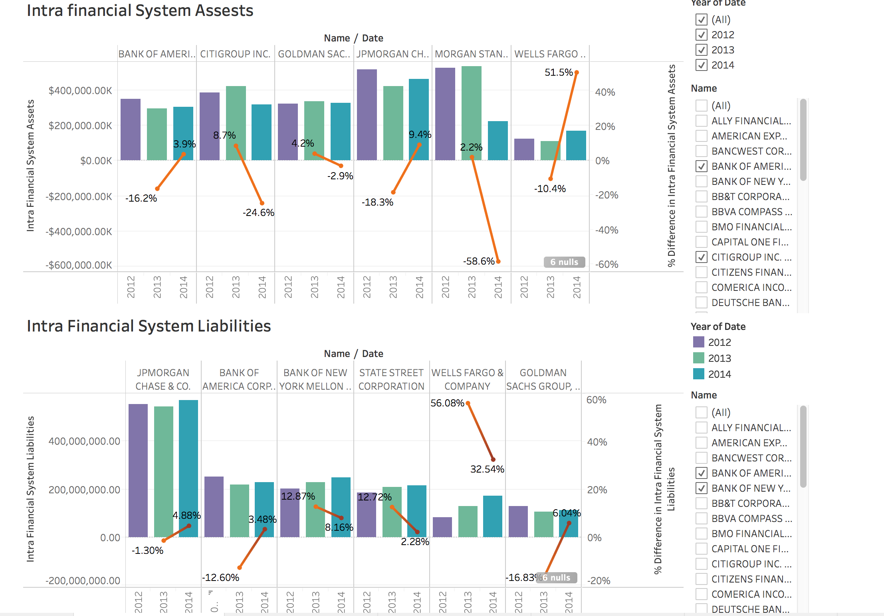

Slide 39
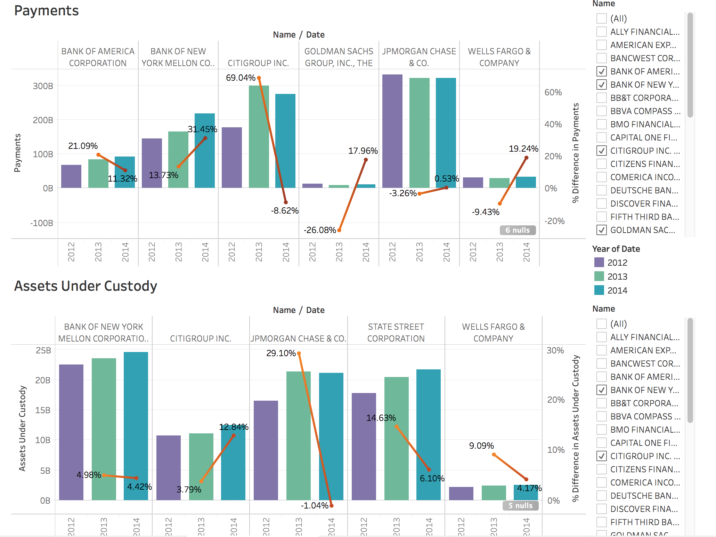

Slide 40
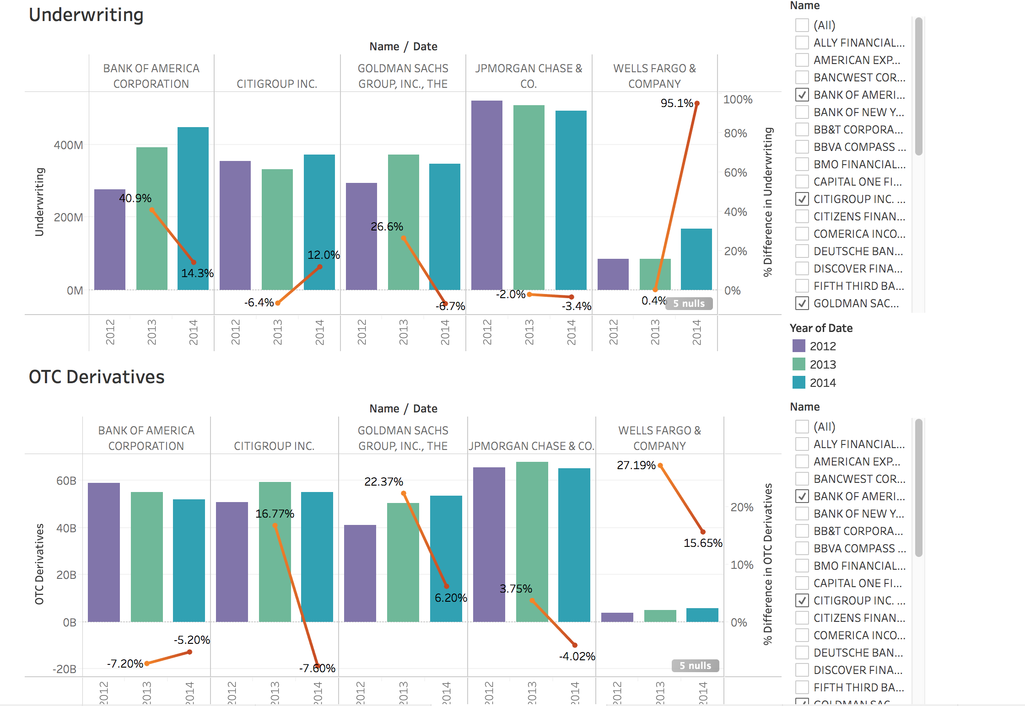

Slide 41
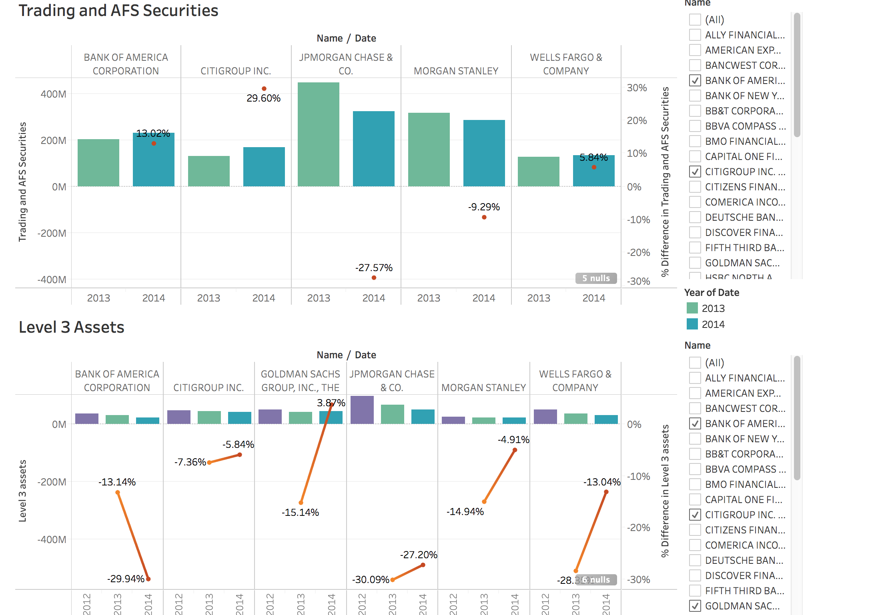

Slide 42
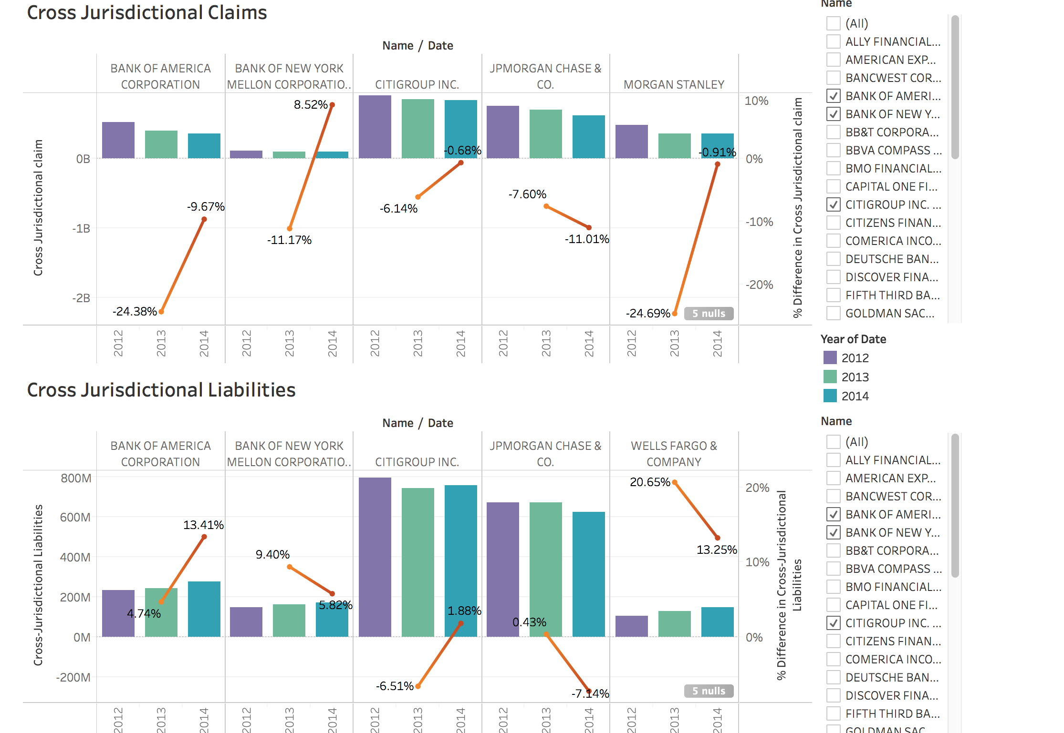

Slide 43
Thank You!

